Slide 1

Smart and Secure Attendance System Using RFID with Motion-Activated Readers, Automated Notifications
Department of Computer Science And Engineering
Second Review
Batch No:06
DATE : 24/04/2025
Presented by
M Sivananthan - 410621104096
V Swetha - 410621104104
M Bhuvanesh - 410621104019
M Md Hasan Billal - 410621104063
Supervisor
Dr. M Sree Rajeswari
Assistant Professor

Slide 2
Objective
Enhance Efficiency: Automate the process of attendance tracking to save administrative time and reduce manual errors.
  Increase Security: Ensure only authenticated individuals can record attendance, enhancing security protocols.
  Real-time Notifications: Enable immediate alerts via SMS/email for absence or irregularities, improving stakeholder awareness.
  Data Centralization: Store attendance records securely on a cloud database for easy access and data analytics.

Slide 3
Introduction
Limitations of Manual Systems
Prone to errors and fraud, lacking real-time data access.
RFID Technology
Radio Frequency Identification enables automated and contactless data capture.
Motion Sensors
Complement RFID by detecting physical presence and unauthorized movement.
Need for Automation
Automated notifications streamline management and reduce delays.

Slide 4
Problem Definition
RFID and IoT Convergence: Combines Radio Frequency Identification (RFID) with Internet of Things (IoT) to create smart environments.
  Automation in Education: Reduces manual attendance processes by integrating technology into educational infrastructures.
  Data-Driven Decisions: Enables educational institutions to make informed decisions based on real-time attendance data.
  Ease of Monitoring: Offers seamless tracking of student and staff attendance without human intervention.

Slide 5
Abstract
Need for Innovation: Traditional attendance methods are outdated and inefficient, necessitating a smarter, automated solution.
  IoT Integration: Utilizes Internet of Things to connect RFID readers to cloud servers for seamless data transmission and accessibility.
  System Features: Includes automatic data logging, real-time updates, and alert notifications to stakeholders.
  Application Scope: Designed for educational institutions but scalable to corporate and event settings.

Slide 6
Requirement Specification
Software
FRONT END TOOLS | Python (Tkinter for GUI)
BACK END TOOLS | MySQL, Google Sheets API, Python
MARKUP LANGUAGES | HTML
SCRIPTING LANGUAGES | JS, Python
MIDDLE WARE TECHNOLOGIES | REST APIs
IDE | Arduino IDE, Visual Studio Code
SIMULATION TOOLS | Proteus, Tinkercad Circuits
NETWORK/WIRELESS TECHNOLOGIES | Wi-Fi / Raspberry Pi
ANY OTHER | SMTP, Google Sheets API
Hardware
RFID reader (MFRC522), Atmega328P microcontroller, power module, and student ID tags.

Slide 7
Fig : Architecture of Smart Attendance System Using RFID
Architecture Diagram
RFID Tag
Motion Sensor
RFID Reader
Microcontroller
Database
(Excel Or MySQL)
Notification System (SMS/Email)

Slide 8
Module Explanation
Login Module: Handles user authentication and access control with role-based interface.
  Admin Module: Enables addition/deletion of users, management of RFID cards, and system settings.
  Attendance Module: Captures RFID data, checks against database, and records attendance.
  Report & Notification Module: Generates reports and sends notifications via email/SMS APIs.

Slide 9
Modules Description
RFID Hardware Module: Comprises RFID tags and MFRC522 reader interfaced with Atmega328P for ID capture.
  Login Interface Module: Developed using Tkinter in Python for secure access and navigation.
  Admin Control Module: Manages user credentials, assigns RFID, and maintains user database.
  Attendance Tracking Module: Communicates with the database to mark and verify attendance in real time.

Slide 10
Algorithm Explanation
Slotted ALOHA
Concept: Tags transmit in random time slots within a fixed frame.
How it works:
  The reader sends a frame with n slots (e.g., 16).
  Each tag randomly selects a slot to transmit its ID.
  Single response in a slot = tag identified.
  Multiple responses = collision → reader asks for retransmission.
  No response = empty slot.
Frequency / Time Division Multiplexing (FDM/TDM)
Concept: Divides the communication bandwidth (FDM) or time (TDM) among tags.
How it works (Time Division):
  Reader defines time slots in a frame.
  Each tag randomly selects one slot to respond.
  Similar to Slotted ALOHA but can be pre-assigned or coordinated.

Slide 11
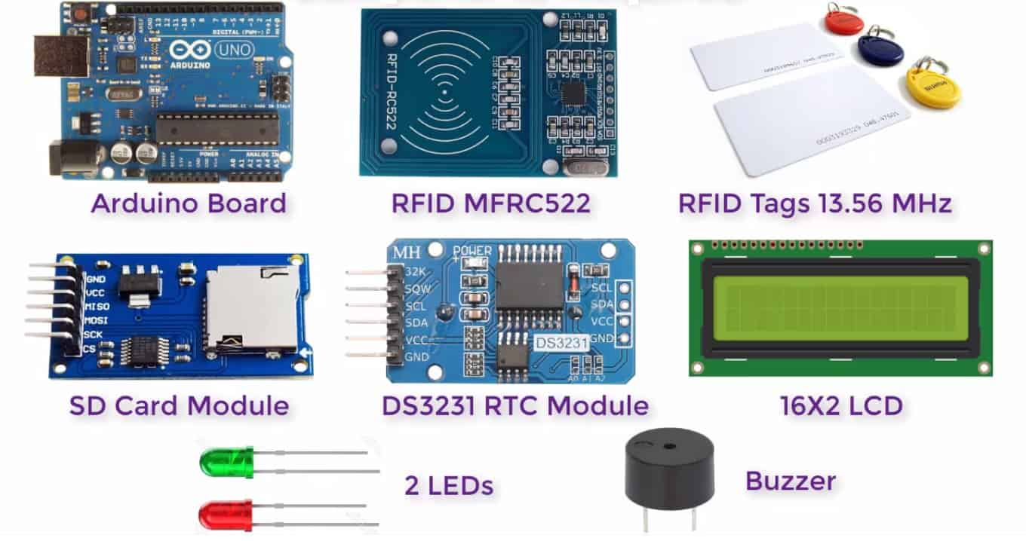
Screen Shots

Slide 12
Conclusion
The Smart and Secure Attendance System provides an efficient, contactless, and automated solution for attendance tracking.
By integrating RFID with motion-activated readers and automated notifications, it enhances security, eliminates proxy attendance, and improves real-time monitoring.
This system ensures accuracy, reliability, and transparency, making it an ideal solution for schools, workplaces, and secure environments.

Slide 13
References
Base Paper Reference:
Lijuan Zheng; Chunlei Song; Ning Cao; Zhaoxuan Li; Wenfeng Zhou; Jianyou Chen.”A New Mutual Authentication Protocol in Mobile RFID for Smart Campus”,vol.6,IEEE, 14 October 2024
Reference Paper:
Keerthana Sanath, Meenakshi K, Muktha Rajan, Varshini Balamurugan, M.E.Harikumar.”RFID and Face Recognition based Smart Attendance System”, IEEE, 2021.
K. Aravindhan, S.K.B. Sangeetha, K. Periyakaruppan, K.P. Keerthana, V. Sanj ay Giridhar and V.Shamaladevi.”Design of Attendance Monitoring System Using RFID”, IEEE, 2021.
Inturi Meghana, J.D.N.V.L. Meghana and Ramesh Jayaraman.”Smart Attendance Management System using Radio Frequency Identification”, IEEE, 2020.
Qianwen Miao, Fu Xiao, Haiping Huang, Lijuan Sun and Ruchuan Wang. “Smart Attendance System Based on Frequency Distribution Algorithm with Passive RFID Tags”, vol.8, IEEE, 2020, pp.217-206.

Slide 14
THANK YOU

